Slide 1


CAPSTONE PROJECT
SUPERSTORE SALESPERFORMANCE
DASHBOARD
Presented By
Student Name: PENDYALA uday kranth
College Name: A.v college of arts ,science and commerce
Department: m.sc(data science)
Email ID:udaykranth01@gmail.com

Slide 2
OUTLINE:
Problem Statement (Should not include solution)
Proposed System/Solution
System Development Approach (Technology Used)
Algorithm & Deployment
Result (Output Image)
Conclusion
Future Scope
References

Slide 3
Problem Statement:
Retail businesses generate large volumes of sales data from different regions, product categories, and customer segments. Analyzing this data manually becomes difficult and time-consuming.
Organizations need an efficient system to:
Monitor overall sales performance
Identify profitable and loss-making products
Analyze sales trends across months and regions
Understand customer segments and shipping preferences
Support data-driven business decision making
However, raw sales data in spreadsheets does not provide clear insights.
Therefore, a data visualization dashboard is required to transform raw sales data into meaningful and interactive business insights.

Slide 4
Proposed Solution:
To address the problem of analyzing large volumes of sales data, a Power BI based Sales Performance Dashboard is developed.
The proposed system provides an interactive data visualization platform that helps analyze and monitor sales performance effectively.
The solution includes the following components:
Data Collection
Import Superstore sales dataset from Excel.
Data Preprocessing
Clean and transform data using Power Query.
Handle missing or inconsistent values.
Data Analysis
Use Power BI to analyze sales, profit, quantity, and order information.
Dashboard Visualization
Create interactive visualizations such as:
Sales by Region
Sales by Category
Sales by Customer Segment
Monthly Sales Trend
Interactive Filters
Users can filter data by:
Year
Quarter
Month
Category
This dashboard helps businesses gain clear insights and make data-driven decisions.

Slide 5
System Approach:
This project follows a data visualization approach using Power BI to analyze the Superstore sales dataset and generate meaningful business insights.
System Requirements
Hardware
Computer/Laptop
Minimum 8 GB RAM
Software
Microsoft Power BI Desktop
Microsoft Excel
Technologies Used
Power BI
Power Query (Data Transformation)
DAX – Data Analysis Expressions
Dataset Used
Superstore Sales Dataset containing:
Order ID
Sales
Profit
Quantity
Category
Region
Customer Segment
This approach helps transform raw sales data into interactive dashboards for better analysis and decision making.

Slide 6
Algorithm & Deployment:
Data Input
The Superstore sales dataset is imported into Power BI from an Excel file.
The dataset contains information such as Order ID, Sales, Profit, Quantity, Category, Region, and Customer Segment.
Data Cleaning & Transformation
Data preprocessing is performed using Power Query.
Missing values and inconsistencies are handled.
Data fields are formatted for analysis.
Data Modeling
Relationships between data fields are created.
Measures and calculated columns are defined using DAX (Data Analysis Expressions).
Visualization Process
Interactive charts and graphs are created to analyze:
Sales performance
Profit trends
Regional distribution
Customer segments
Deployment
The dashboard is published through Power BI Service for sharing and real-time access.

Slide 7
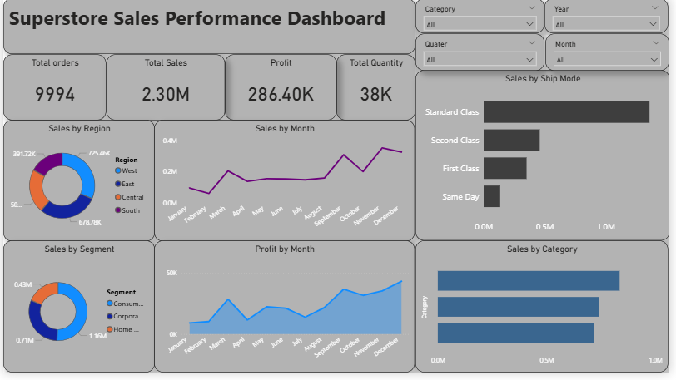
Result:
The Power BI dashboard successfully visualizes the Superstore sales dataset and provides meaningful insights into business performance.
The dashboard displays key performance indicators such as:
Total Sales
Total Profit
Total Orders
Total Quantity Sold
It also provides detailed analysis through visualizations such as:
Sales by Region
Monthly Sales Trend
Profit by Month
Sales by Category
Sales by Customer Segment
Shipping Mode Analysis
The interactive filters allow users to analyze data based on year, quarter, month, and category, enabling better decision-making.

Slide 8
Conclusion:
The Power BI dashboard successfully analyzes the Superstore sales dataset and provides clear insights into business performance.
The dashboard highlights important metrics such as total sales, profit, orders, and quantity sold. It also visualizes sales distribution by region, category, customer segment, and shipping mode.
The interactive filters enable users to explore data across different years, quarters, and months, making the analysis more flexible and informative.
Overall, the dashboard helps businesses understand sales trends, identify profitable areas, and support data-driven decision making.

Slide 9
Future scope:
The project can be further enhanced with additional features to improve data analysis and decision-making.
Integrate real-time sales data for live business monitoring
Add predictive analytics using machine learning to forecast future sales trends
Expand the dashboard with customer behavior and product performance analysis
Deploy the dashboard on Power BI Service or cloud platforms for easy access and sharing
Include advanced visualizations and automated reporting systems
These improvements can help organizations gain deeper insights and better strategic planning.

Slide 10
References:
The development of this project was supported by various learning resources and documentation. The primary reference used was the official Microsoft Power BI Documentation and Microsoft Learn platform, which provides detailed guidance on Power BI tools and features. The Superstore Sales Dataset obtained from Kaggle was used for performing the data analysis and visualization. Additional knowledge and best practices for data visualization were gathered from Power BI tutorials available on the Microsoft website and Power BI community resources.
GitHub Link: https://github.com/Uday2kranth/Superstore

Slide 11
Thank You

